Slide 1



Sentiment Analysis on Customer Reviews
B Y
CHINMAY JAPE

Slide 2
OBJECTIVE
Given a set of customer reviews and product related features, use sentiment analysis to determine the emotional tone behind a series of words and gain an understanding of the attitudes, opinions and emotions expressed about the products.
THE DATA
Number of Data Points : 1188
Number of Attributes : 14
Number of Relevant Categorical Variables : 6
Attributes ‘Brand’ and ‘Review Header’ contains 111 and 24 null values respectively.
972 5-Star reviews out of a total of 1188.
2

Slide 3
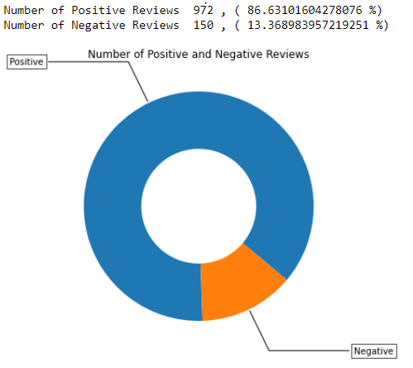
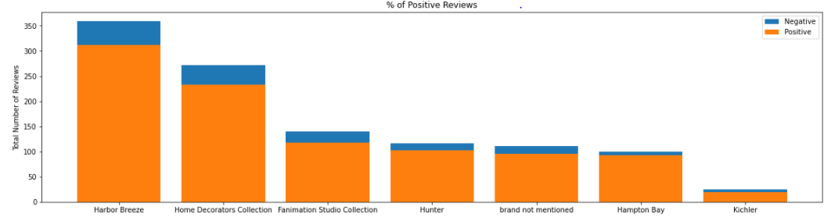
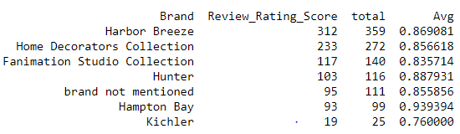
Univariate Analysis on the Categorical Variables
The dataset is highly biased towards positive reviews. We will have to take care of this situation during model building.
3

Slide 4
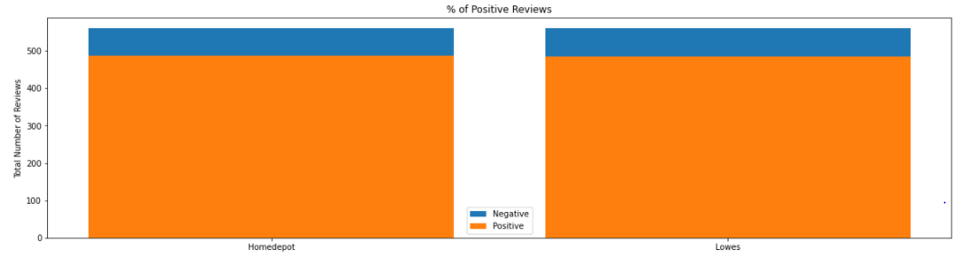




Univariate Analysis on the Categorical Variables
3

Slide 5

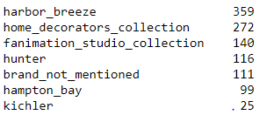

Text Preprocessing
Steps Involved:
Stop Words Removal
Removal of Punctuations
Lowering the upper case letters
Processing special characters and spaces between the sentences
Expanding contracted English words
Using regular expressions to preprocess the text data.
Replacing white spaces in categorical variables with underscore.

Slide 6
Text Preprocessing - Continued
Features to be used for Bag of Words and TFIDF:
Preprocessed Review Text
Preprocessed Review Text Header
Cleaned sample review text after preprocessing:
Dataset After Text Preprocessing
This dataset contains the final preprocessed text and categorical data
The dataset contain 1122 rows and 14 columns.
The final data file is saved in csv format and will be used for further analysis.

Slide 7
Modeling:
Naïve Bayes Classifier with Bag of Words and TFIDF
Calculating sentiment scores of review text using nltk
Splitting the dataset in train and test set using random sampling
Applying Bag of Words and TFIDF on Review Text and Review Header
Encoding Numerical and Categorical Features
Concatenating all the final set of features
Hyperparameter Tuning using GridSearchCV on Multinomial Naïve Bayes Model.
Selecting the best hyperparameter to build our final model.
Plotting ROC-AUC Curve, Confusion Matrix.
Finding the Top 20 features in the positive and negative classes.

Slide 8
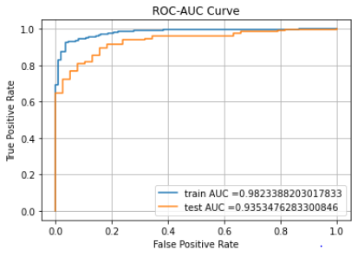
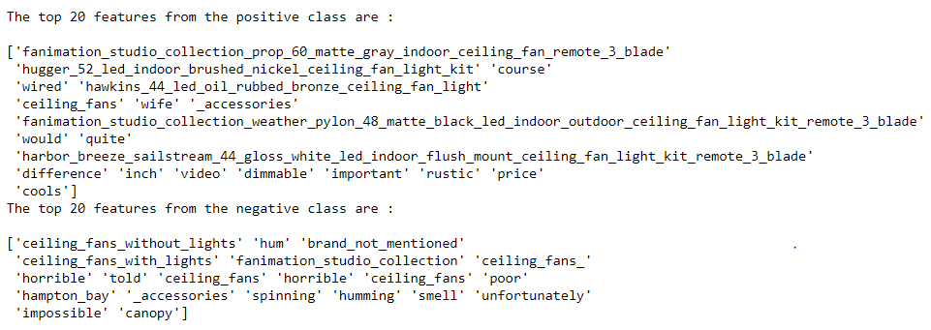
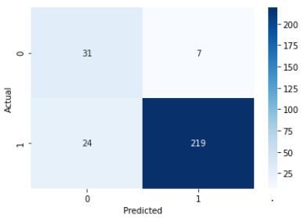
Modeling:
Naïve Bayes Classifier with Bag of Words

Slide 9
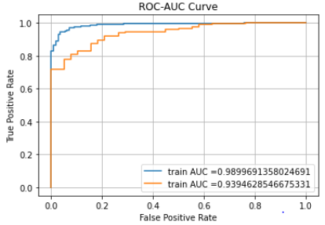
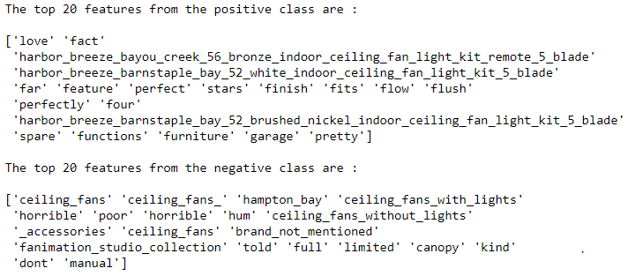
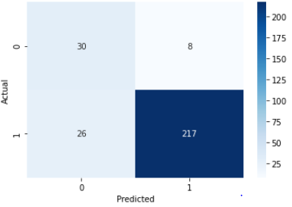
Modeling:
Naïve Bayes Classifier with TFIDF

Slide 10
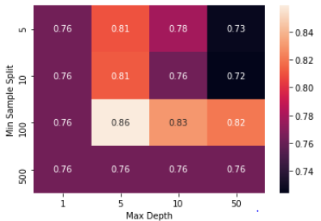
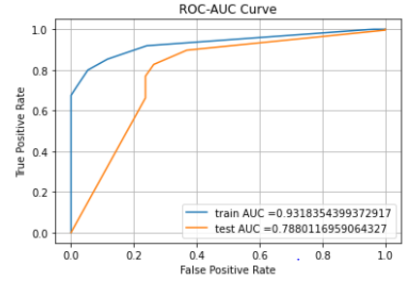
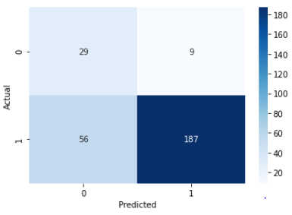
Modeling:
Decision Tree Classifier with Bag of Words

Slide 11
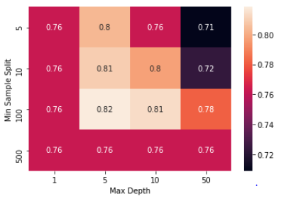
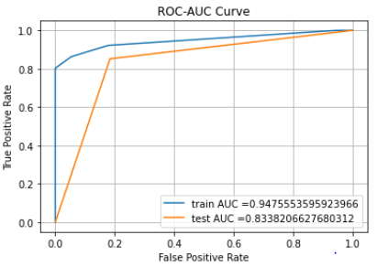
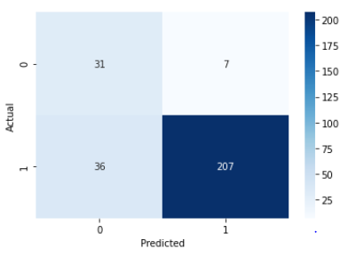
Modeling:
Decision Tree Classifier with TFIDF

Slide 12
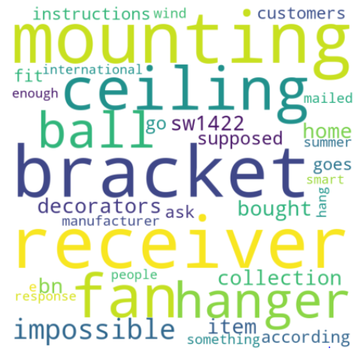
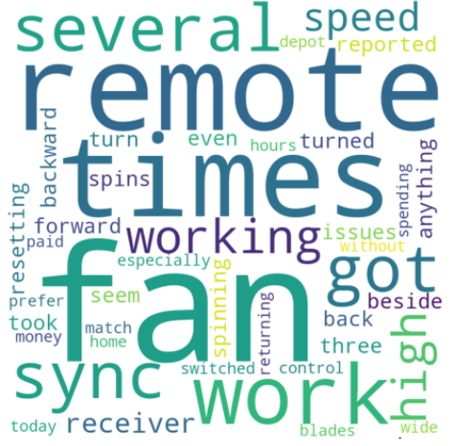
Modeling:
Decision Tree Classifier Word Cloud on BOW and TFIDF

Slide 13
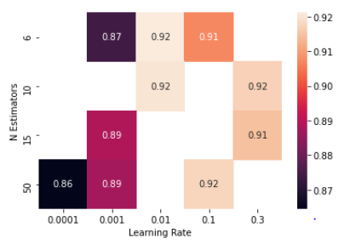
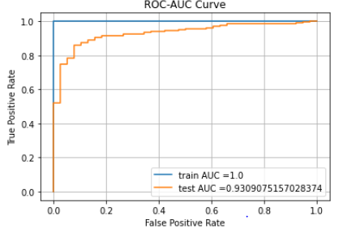
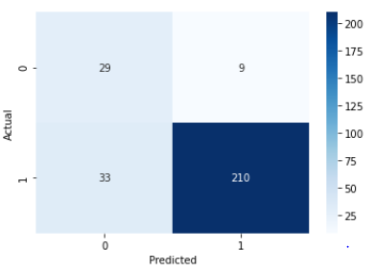
Modeling:
Light GBM with Bag of Words

Slide 14
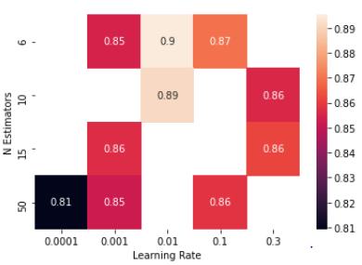
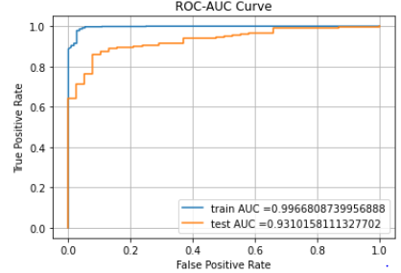
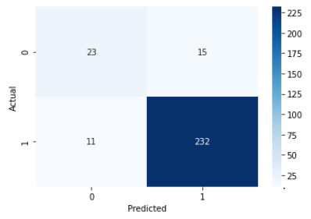
Modeling:
Light GBM with TFIDF

Slide 15
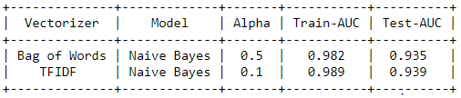
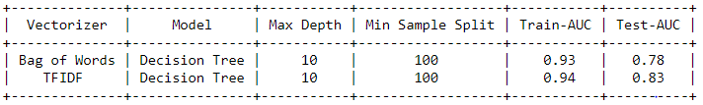
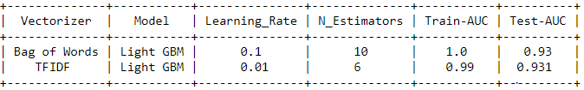
Comparing the Models

Slide 16
Useful Insights from the Analysis:
87% of the user reviews on the products are positive with a rating of 4 or 5.
Top 3 brands by volume are Harbor Breeze, Home Décor and Fanimation Studio capturing 65% of the market share volume.
Top 20 features from the positive class contain 3 of the Harbor Breeze Products.
Ceiling Fan Without Lights is the top negative feature.
Recommendation on Final Model:
Comparing the performance of 3 models on the test data and considering AUC score as the test statistic we recommend Naïve Bayes model with TFIDF [AUC : .939] as our final model for predicting the sentiment based on the given set of features.

